Slide 1
Tit for Tattling: Cooperation, communication, and how each could stabilize the other
by
Victor Vikram Odouard and Michael Holton Price
Santa Fe Institute, 1399 Hyde Park Road, Santa Fe, NM 87501
Presentation by Emanuele Di Sante

Slide 2
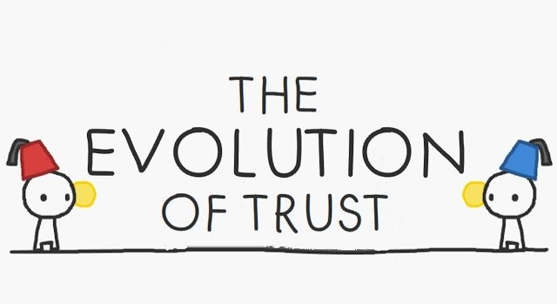
https://ncase.me/trust/

Slide 3
The evolution of altruism
Altruism → Helping others at a personal cost
All explanation for the evolution of altruism ensure that altruists receive a second-order benefit that compensates the initial cost
Indirect reciprocity →individuals have their favors returned even by third parties
Communication (in indirect reciprocity) is required to disseminate reputation
Under what conditions does the interaction between signaling and cooperation stabilize both high levels of (altruistic) cooperation and truthful, informative, and effective communication?

Slide 4
Cooperation, communication, stability
The agents evolve rules to
  Act in a prisoner’s dilemma
  Communicate about the actions of others
Under the conditions that allow for a stable cooperative-communicative state, agents
  act and signal according to an aligned norm
  occasionally deviate from their strategy
  exert normative pressure on each other's signals → favors truthfulness

Slide 5
Background, Cooperation
Strategy → set of rules for acting and signaling
Norm → strategy that encodes a set of rules that is followed by the large majority of a social group
Standing → defined recursively: some-one is in good standing if they cooperated, or if they defected against someone in bad standing, and to cooperate with agents iff they are in good standing
Stern judging → similar to standing, additionally puts those who cooperate with those in bad standing into bad standing.

Slide 6
Background, Communication
The stability of honest communication systems usually rely on some kind of pressure on the signaler to be truthful
In its basic form, communicating the reputations of others places no such pressure on the signaler
Truthfulness is not the only requirement: agents also need to be forthcoming (actually share the information they have)
The stable strategy deals with it by treating failures to signal in the same way it treats lying

Slide 7
Communication
Communication system → set of mappings from meanings to symbols
A communication system is effective when it is→
  Uniform → everyone abides by the same mapping from meanings to symbols (corresponds to truthfulness)
  Forthcoming → agents never fail to signal when they possess relevant information
  Informative →everyone’s mapping distinguishes between at least two meanings (guarantees that some information gets transmitted)

Slide 8
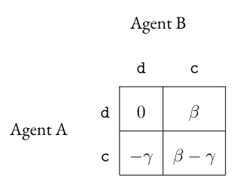
Cooperation and Stability recalls
Cooperation is paying a cost, γ, for the benefit, β, of someone else
Agent A’s payoff in the prisoner’s dilemma. d stands for defect and c stands for cooperate.
A strategy is stable if no other strategy can invade it
That is, no other strategy can proliferate in a population of 100% A-type agents (when A is said to ‘predominate’).

Slide 9
Model 1: A first pass
Infinite number of rounds, agents interact in prisoner’s dilemma
Agents “tag” each other, each agent has one tag at a time
Each round everyone pairs up at random and makes a choice (cooperate/deflect). An agent’s choice may depend on their partner’s current tag.
Everyone signals a new “tag” for their partner (This process can be imagined as your partner writing a 0 or 1 on your forehead for your next partner to see, as the signal need only be known to one’s next partner)
Each agent can use whatever mapping they desire

Slide 10
Model 1: Strategies
We want to find the focal strategy, that is, a strategy that leads to a stable, highly cooperative and effective communicating population.
Action Strategies
Signal of actor’s new tag
Name | ID | Act for 0s | Act for 1s
Deflector | dd | d | d
Discriminator | dc | d | c
Reverse-discriminator | cd | c | d
Cooperator | cc | c | c
Partner’s tag | Actor’s action | Image scoring | Standing | Stern Judging
0 | d | 0 | 1 | 1
0 | c | 1 | 1 | 0
1 | d | 0 | 0 | 0
1 | c | 1 | 1 | 1

Slide 11
Model 1: Focal strategy
Stern discriminators as candidates to analyze for this model
  Action: coop with 1s, defects with 0s
  Signaling: tags cooperation with 1-agents and defection with 0-agents with a 1, and cooperation with 0s and defection with 1s with 0.
Analysis
  Is the state cooperative?
  Does the state effectively communicate?
  Is it stable?

Slide 12
Model 1: Analysis
Is the state cooperative? ✅
  All who follow the stern discriminator strategy receive a tag of 1, so everyone will receive a 1-tag to start the second round, and thus, everyone will cooperate in the second round and so on. All rounds except the first are fully cooperative
Does the state effectively communicate? ✅
  all agents abide by a separating, uniform mapping (as specified by the stern judging norm), and never withhold information
Is it stable? ❌
  No payoff difference between individuals with the same action strategy but different languages (a ‘pushover’ discriminator that signals 1 about everyone does just as well as a stern discriminator)
  Some traits are unexpressed (eg. Everyone cooperates, everyone receives a tag of 1)
  A different strategy that exploit either of the above can invade

Slide 13
Model 2: Next!
Addressing instabilities
  Unpunishability of language → Meta-signaling tags agents based on their signal
  Unexpressed traits → Error creates diversity
Each round agents are either actor or observer
Observers are assigned randomly (to actors or another observer)
Actors interact in a prisoner’s dilemma, using their strategies with error rate ϵ and signal by tagging each others with error rate δ
Observers ‘meta-signal’ whether they agree or disagree with the obervee’s signal, and tag the accordingly to their meta-signaling strategy with error rate δ, overwriting the observee’s tag.

Slide 14
Model 2: Analysis
Focal strategy → Stern discriminator, meta-signaling strategy: 0 if they disagree, 1 if they agree.
Is the state cooperative? ✅
Does the state effectively communicate? ✅
  Because of errors there are a nonzero portion of defections, but that portion can be made arbitrarily small by shrinking ϵ and δ.
Is it stable?
  We need to ensure that:
    Any strategy that deviates from the stern discriminator does strictly worse
    No latent traits exist that will cause invading strategies to be indistinguishable from stern discriminators.

Slide 15
Model 2: Any alternative strategy does worse
Whenever an agent makes any decision there are three possible consequences of that decision:
first-order costs → immediate costs paid for a decision (eg. paying γ for cooperating)
second-order costs → costs borne for a decision in the subsequent action round (eg, their subsequent partner defects with them for having a 0-tag)
effects on future scenarios → the present decisions of agents may affect the conditions surrounding their future decisions, potentially affecting payoffs.

Slide 16
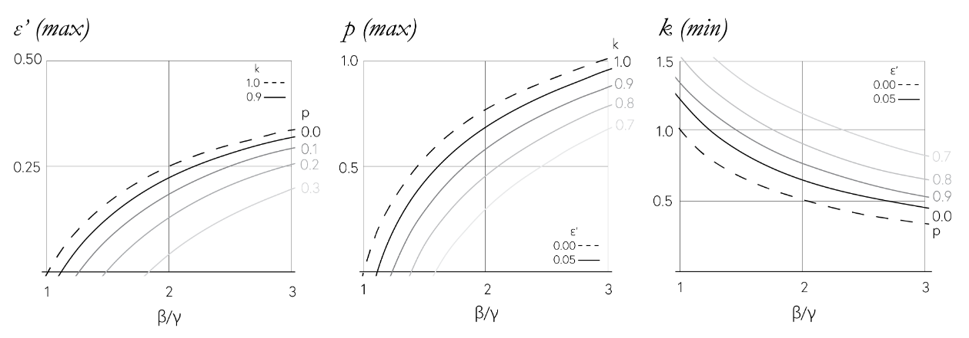
Model 2: Values for strategy stability
Effective error rate ϵ′ → combination of ϵ and δ
Probability of being an observer p
Discounting factor k → determines the present value of a series of future cash flows

Slide 17
Model 2: All traits are expressed with error
Any strategy that deviates from the stern discriminator does strictly worse ✅
No latent traits exist that will cause invading strategies to be indistinguishable from stern discriminators. (✅)
There are three safeguards against the problem of unexpressed traits.
  Any bounded world state comes to pass (assuming infinite time), due to error
  Minimal relevant information is available to an agent in any given round, paring down the plausible world states to a set whose members are all reasonably likely to occur.
  Rare world states are extremely difficult to exploit because they rely on the confluence of deviations of many agents, which is very unlikely to occur.

Slide 18
Discussion: Meta-signaling
The concept of meta-signaling makes it clear why it makes sense to study the evolution of communication in the context of cooperation.
It’s what makes altruism conventionally stable
Meta-signaling co-opts the indirect reciprocity mechanism for the purposes of maintaining the communication system
The core innovation was repurposing a technology for the analogous purpose of maintaining itself, saving the effort of maintaining a separate system.
it sets up a positive feedback loop: enhancements to the system lead to further enhancements

Slide 19
Discussion: Norms & Equilibrium
Communicating moral judgments (good/bad) simplifies complex behavior by collapsing detailed chains of actions into simple moral categories.
Instead of tracking who cooperated or defected through complex histories, agents only need to know whether someone’s action aligns with a “good” or “bad” tag.
Stern discriminators outperform all other strategies, thus making the equilibrium robust
Although there could be stable but defect-oriented states, group selection would favor cooperative groups due to low defection tendencies.

Slide 20
Discussion: Social enforcing & Reputation
Social enforcement of truthful signaling has two main advantages
  it can flexibly set costs to maintain truthfulness
  it’s resistant to destabilization by selection pressures
Reputation is crucial across social interactions, helping agents decide whom to cooperate with and how to administer punishment.
This reputation system evolved to facilitate cooperation but has since been adapted for third-party punishment, enabling social order in complex groups.

Slide 21
Conclusions
This study identifies three stability conditions for a basic communication system:
  Meta-signaling
  error tolerance
  stern judging norms
The logical next research step would be about Alternative equilibria, exploring alternative pathways or Complex communication, investigating more elaborate language systems (reinforced learning, cognitive limits).

